Slide 1
PANEL DISCUSSION: “How Can Multiphase Flow Modeling Have the Same Impact on Process Industry as Single-Phase Flow Modeling?”
James Parker
CPFD Software

Slide 2
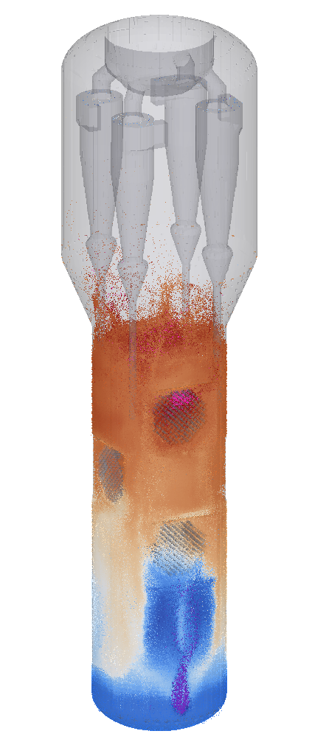
My perspective
Engineering services for industrial-scale systems
FCC, polyolefins, gasifiers, CFB boilers, dryers, polysilicon reactors, ore roasters, flue gas desulfurization, chemical looping, …
Three-dimensional, reacting, non-isothermal
Delivery time in 3 to 4 months
Particle temperatures
in black liquor gasification
simulation
Notes:
Goals, summaries, and demonstration.
First, a some context

Slide 3
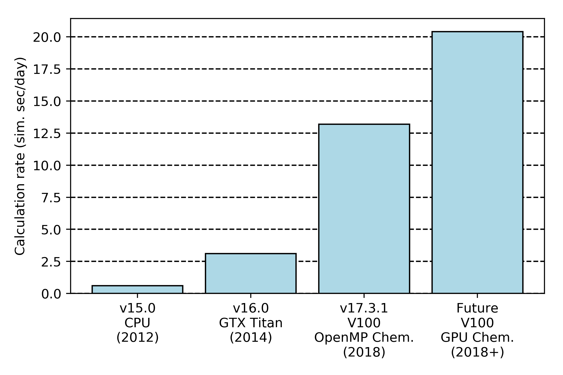
Current challenges
Calculation rate of NETL CLR model
Obtaining a simulation solution in an engineering timeframe
Quality of inputs
Model input data
Particle characterization / drag
Notes:
Goals, summaries, and demonstration.
First, a some context

